Slide 1


Hotel Analysis
Jennifer Yun
Kristan Rodriguez
James Crawford

Slide 2
Dataset Introduction
SourceData: https://raw.githubusercontent.com/rfordatascience/tidytuesday/master/data/2020/2020-02-11/hotels.csv​
Contains 119,390 observations for a City Hotel and a Resort Hotel​
Represents hotel booking data collected between 7/1/2015 and 8/31/2017​
Data source is of hotels located in Portugal​
Dataset originally from article written by Antonio, Almeida and Nunes (2019)

Slide 3
Columns Used in the Dataset
Total Variables in Original Dataset
32
Columns Used to Conduct Analysis
Lead Time
Arrival Month
Arrival Week Number
Reserved Room Type
Meal
Distribution Channel
Adults
Children
Babies

Slide 4
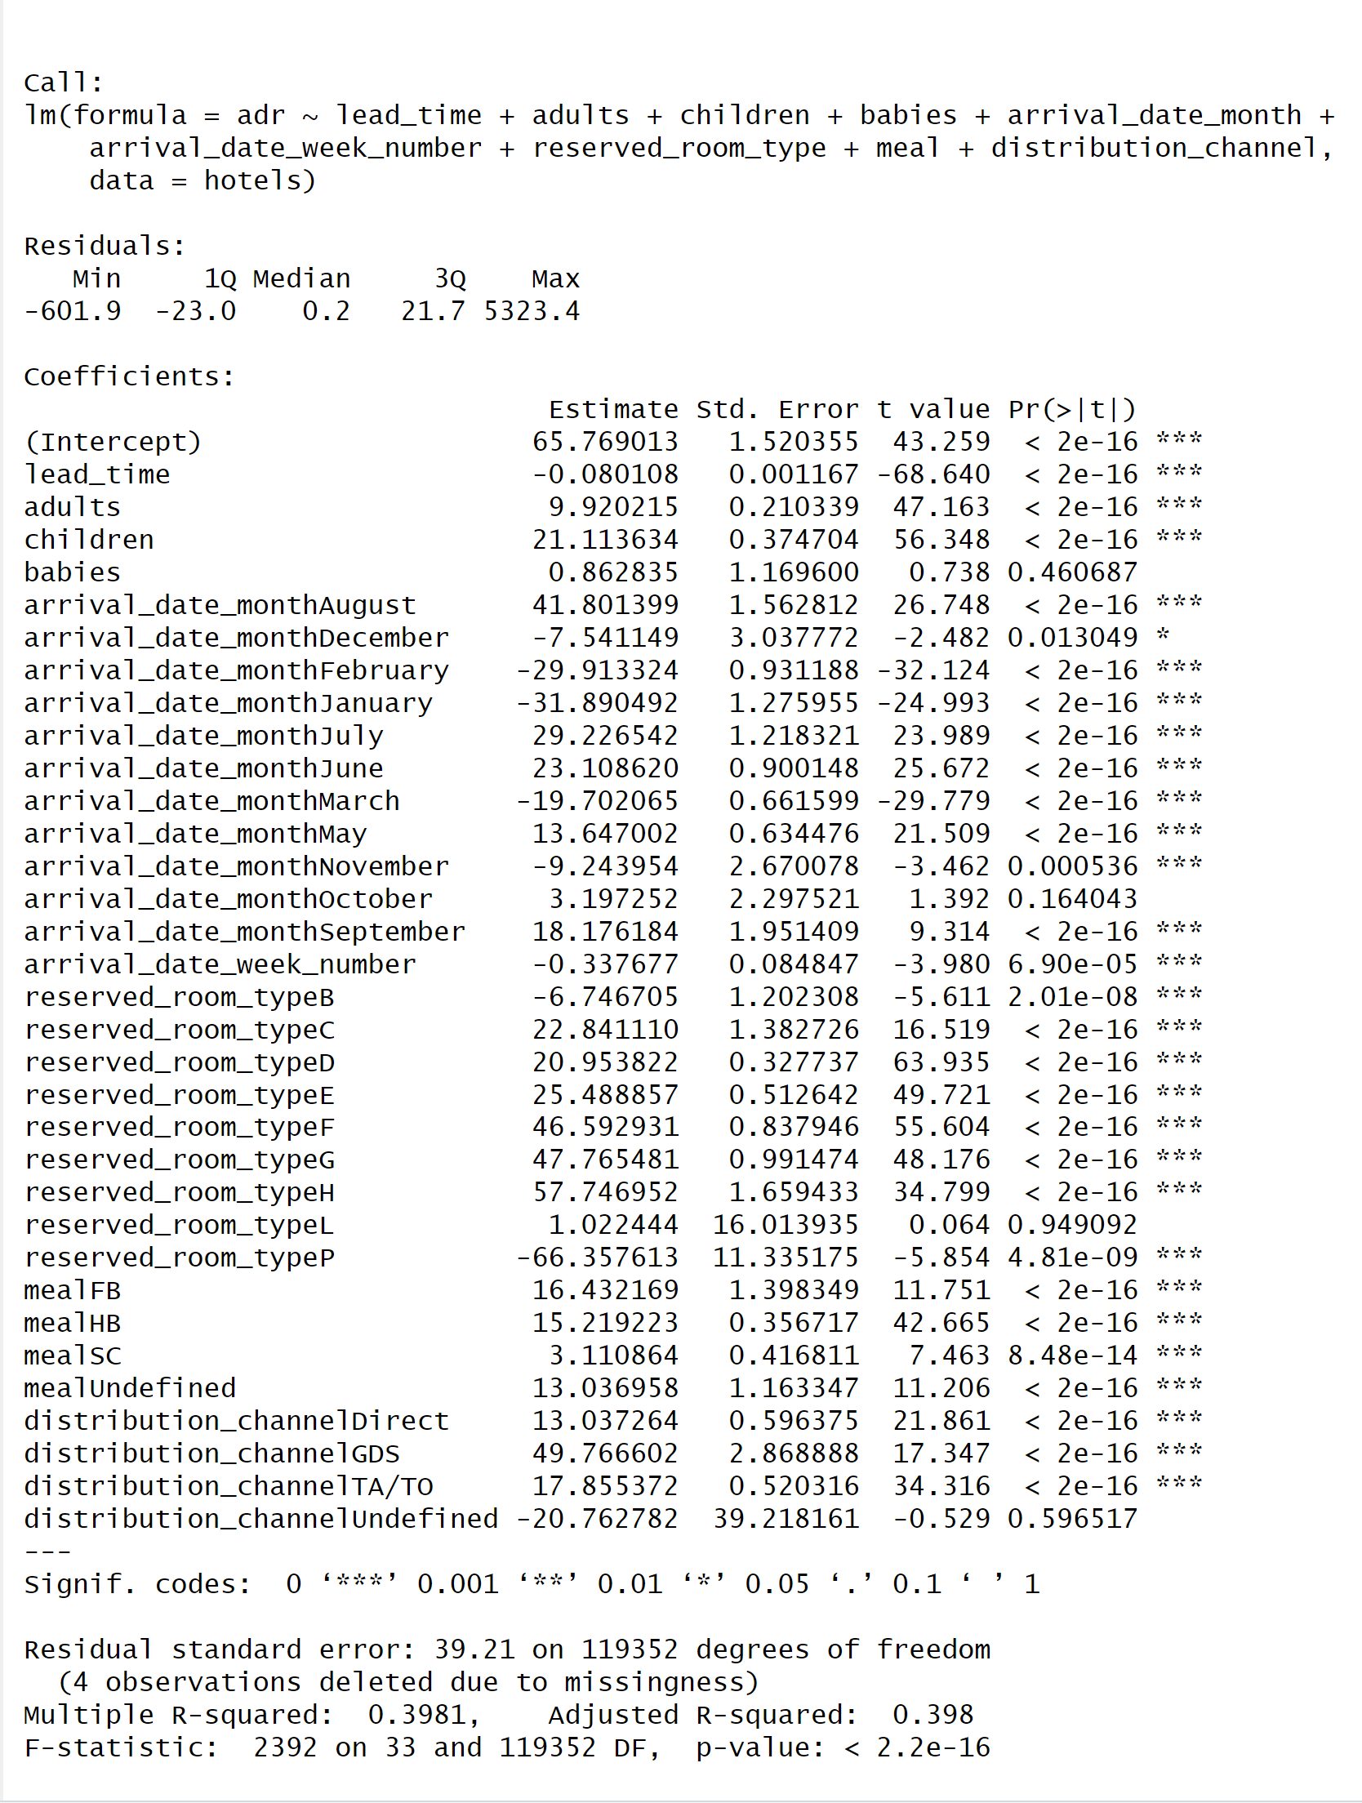




Regression Model
Predicting Average Daily Rate (ADR)
Multiple Predictors Used
Independent/Dependent Variables
Significant Predictors
Adjusted R-squared Value 40%
Notes:
Focus on low producing months December, January, February
Show (average daily rate graph, average number of bookings per month)
by average rate by year.

Slide 5
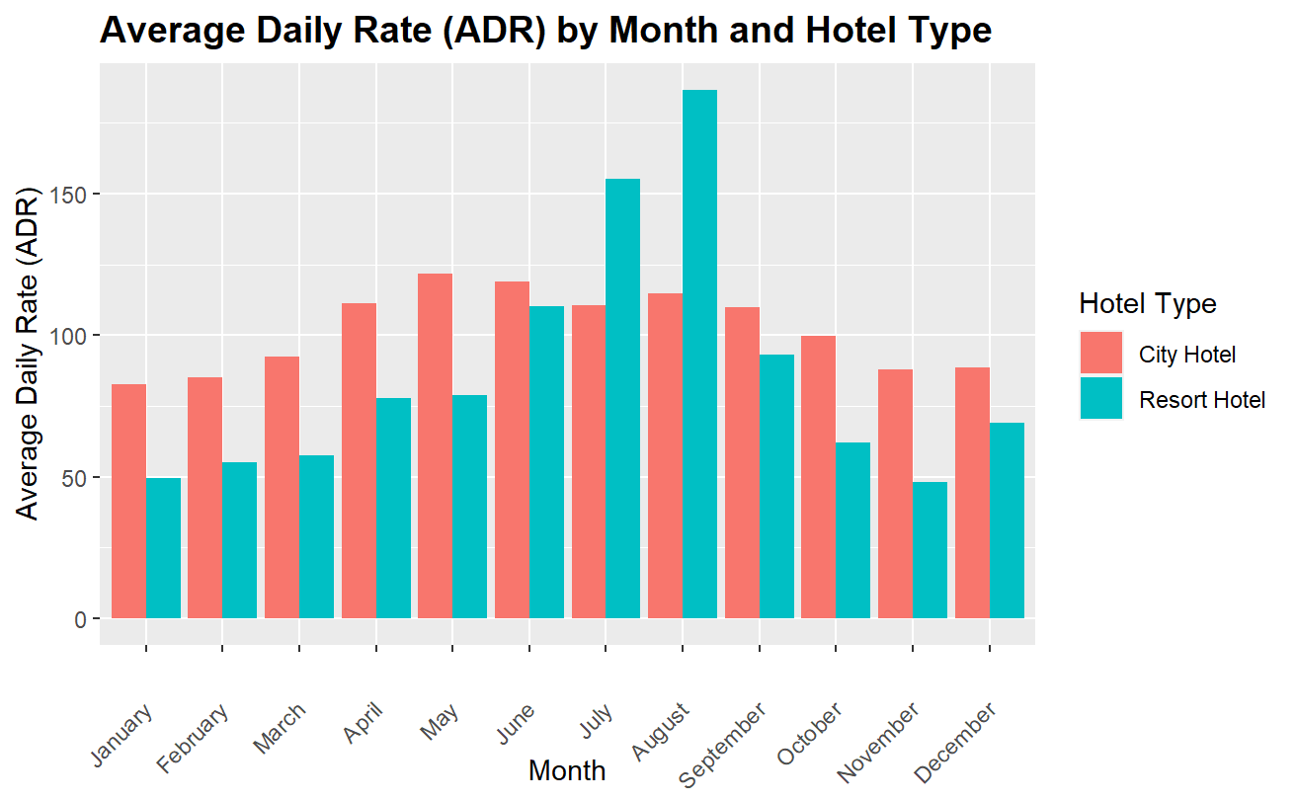
Average Rates: City VS Resort
Summer Months High Daily Rates
Winter Months Low Daily Rates
Resort vs City Hotel Comparison

Slide 6
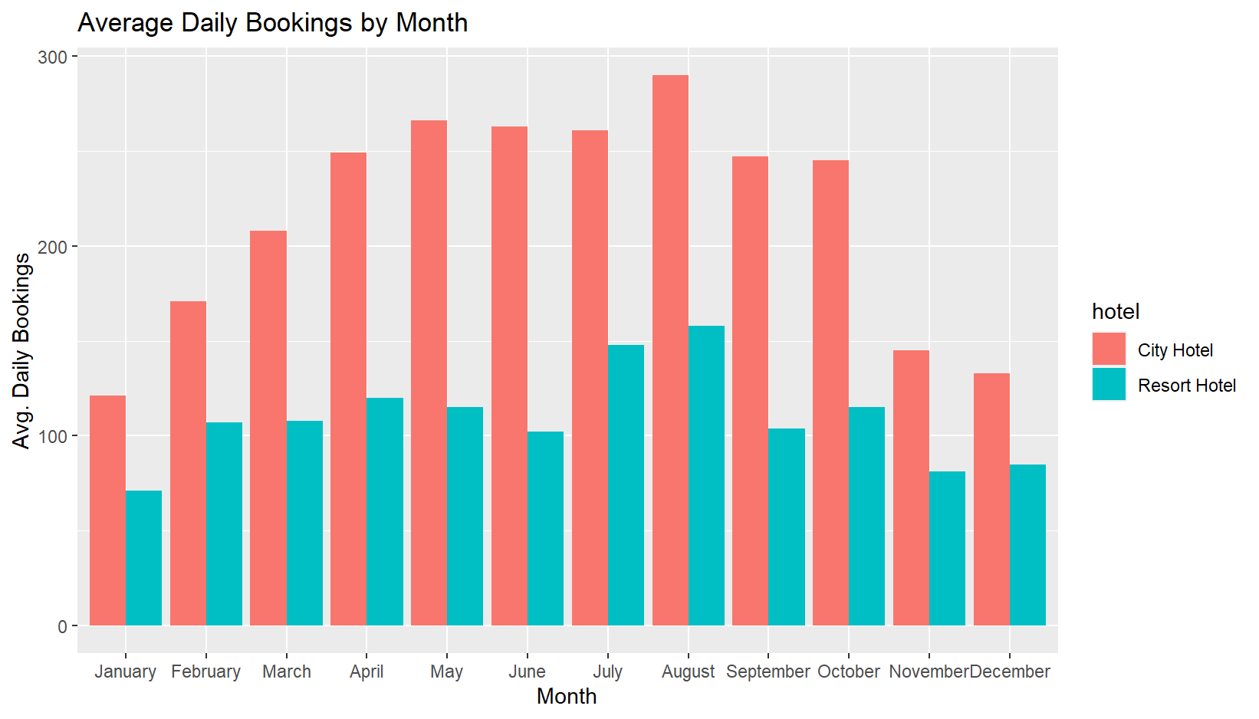
Average Daily Bookings: City VS Resort
City Experiences High Number of Bookings
Peak in Bookings During Summer
Check-in VS Cancellations

Slide 7
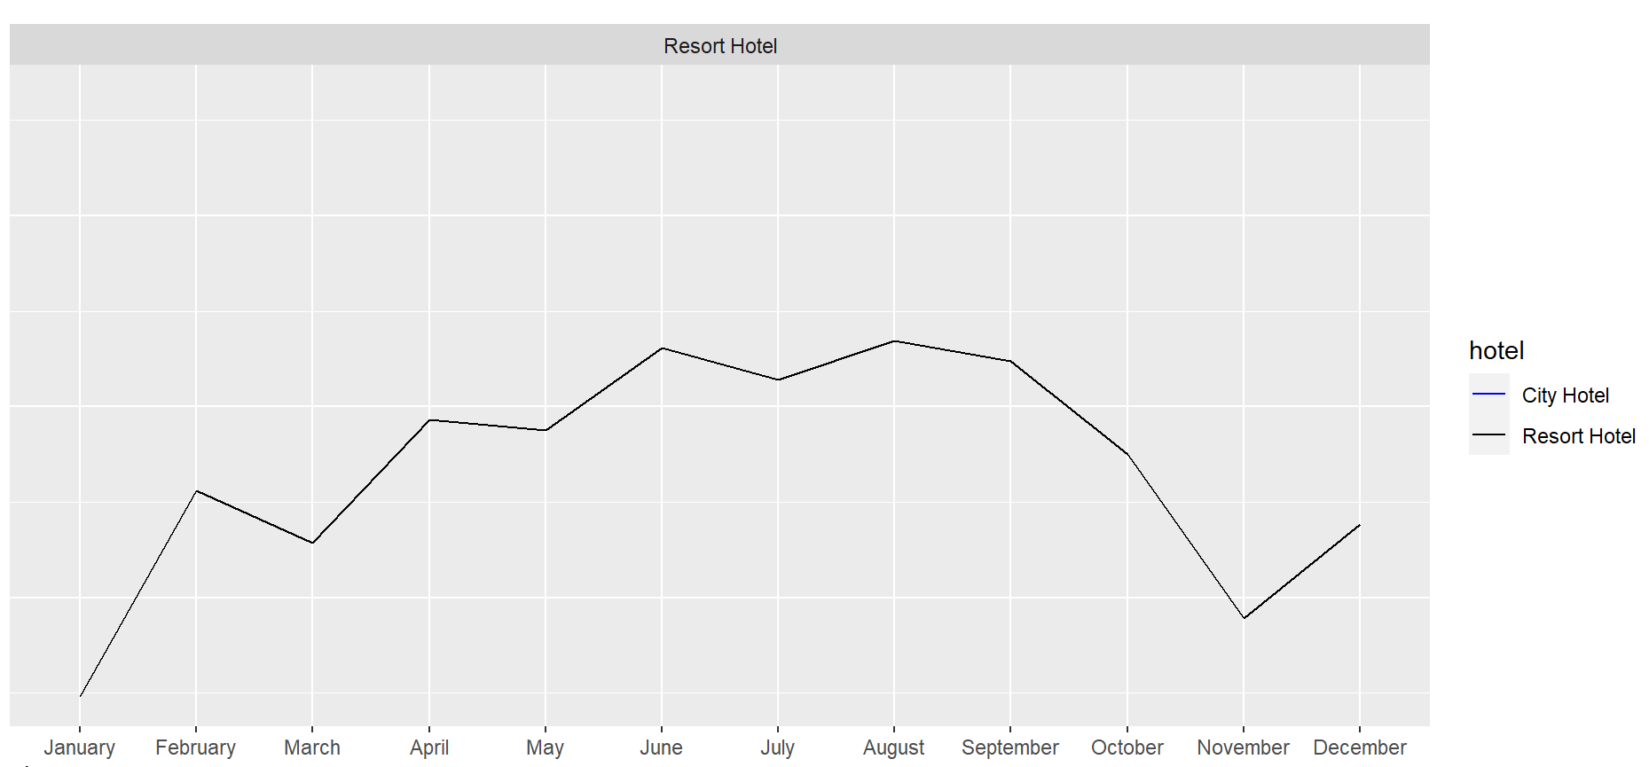

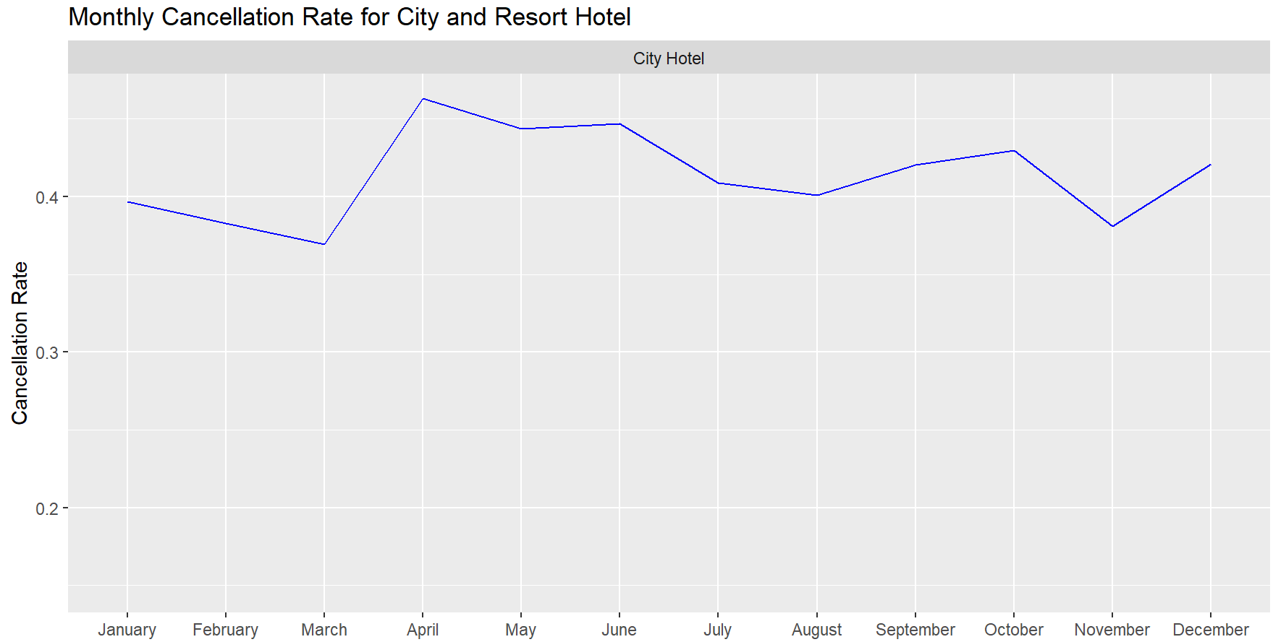
City Hotel VS Resort Cancellation Rate
City Hotel Experience Highest Cancellations

Slide 8
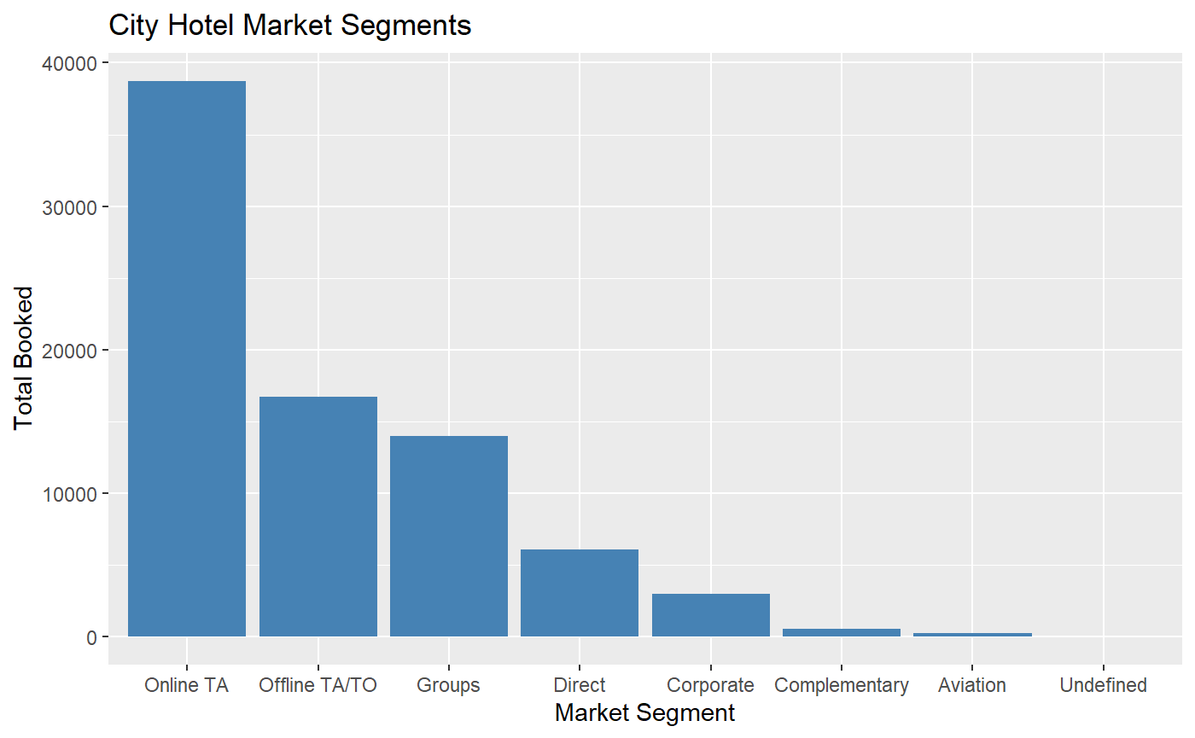
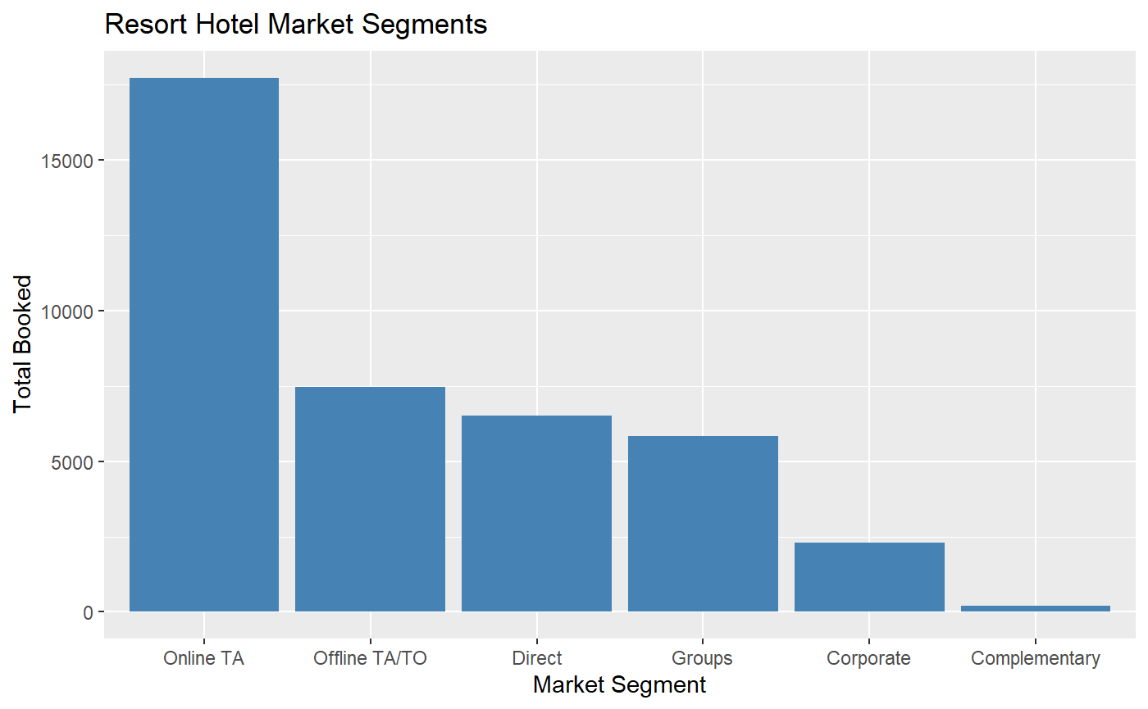
Bookings by Market Segment
Online Travel Agency Highly Used
Target Promotions Towards Online TA
Majority of the Market Revolves Around City Hotels

Slide 9

Create Business Strategies
Increase Number of Booking for Low Months
Decrease Cancellations
Offer Promotions to Attract Other Booking Market Segments

Slide 10
Increase Number of Bookings for Low Months
Special Promotions
Partner Collaborations and Local Attractions
Adjust for Low Season, Adjust Room Rates Based on Demand or Implementing Minimum Night Stays

Slide 11
Decrease Cancellations
Monitor Booking Patterns
Enhance Booking Experience
Manage Over-Booking

Slide 12
Offer Promotions to Alternative Market Segments
Offer Commission or Bonus to Travel Agents
Discounts for Booking Directly (Website or Phone)
Loyalty Program (Corporations)

Slide 13
Conclusion
Goal
To implement business strategies to increase bookings and revenue during low booking months
Regression model analysis
Having children & month of August increase ADR
Higher lead time decreases ADR
Business strategies
Increase number of bookings for low peaked months
Decrease cancellations
Offer promotions to alternative market segments

Slide 14
Q & A

